Slide 1
Dow Host A and B Lifetime Update and Identifying Trends with Host Energetics and Device Stability
John Bangsund
Kyle Hershey
2017-11-20

Slide 2
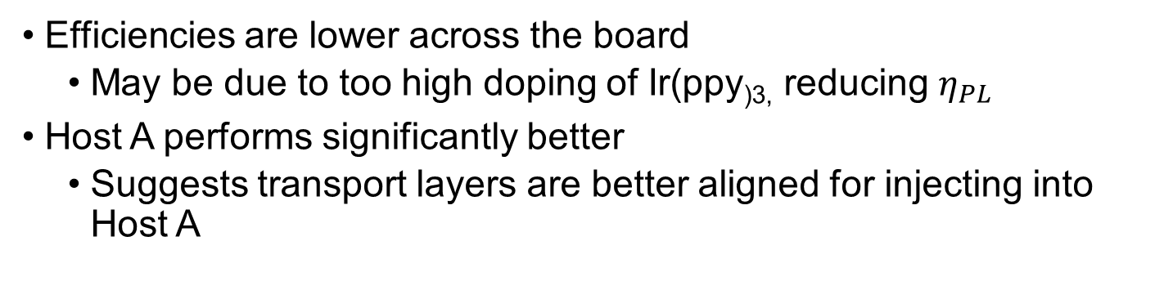
Efficiency with Standard Transport Layers
LiF + Al
TPBi 30 nm
Host:Ir(ppy)₃ (15%) 40 nm
TCTA 20 nm
AQ1250/ITO/Glass
Efficiencies are lower across the board
May be due to too high doping of Ir(ppy_{)3,} reducing $η_{PL}$
Host A performs significantly better
Suggests transport layers are better aligned for injecting into Host A

Slide 3
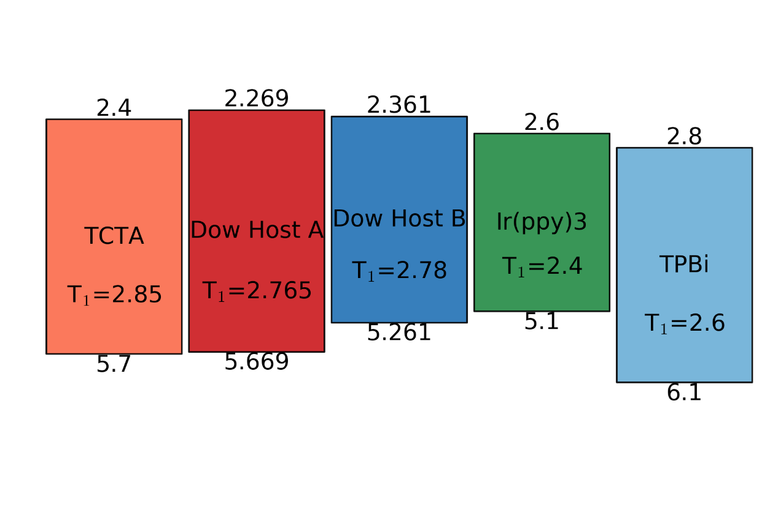
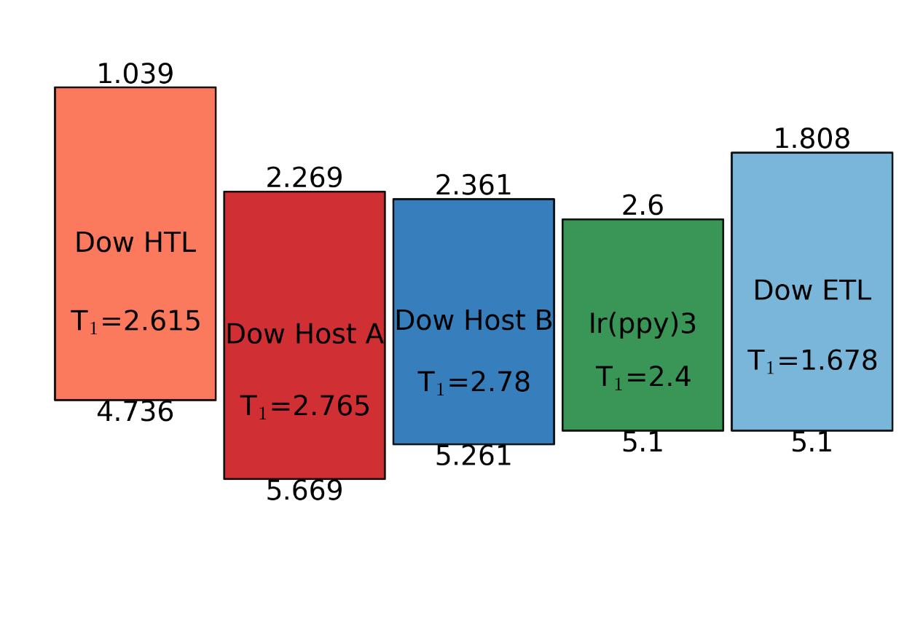
Energy Levels
LUMO of Host A and B taken as HOMO + E_{g}
Reduced hole-injection barrier for TCTA/Dow A
May explain difference in EQE roll-up
Could use TAPC or NPD, which have shallower HOMOs of 5.4 – 5.5 eV

Slide 4
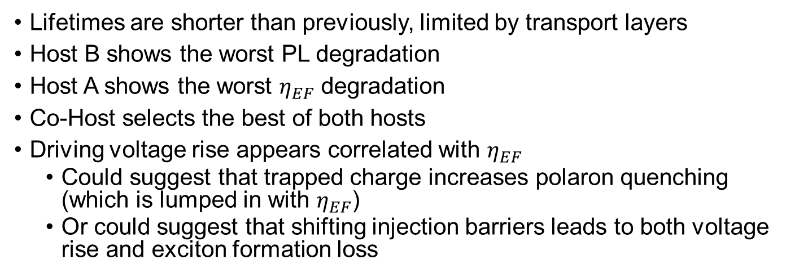
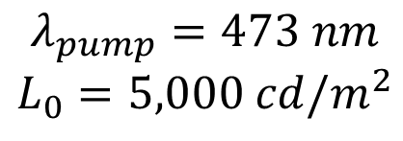
Lifetimes
$$λ_{pump}=473 nm$$
$$L_{0}=5,000 cd/m^{2}$$
Lifetimes are shorter than previously, limited by transport layers
Host B shows the worst PL degradation
Host A shows the worst $η_{EF}$ degradation
Co-Host selects the best of both hosts
Driving voltage rise appears correlated with $η_{EF}$
Could suggest that trapped charge increases polaron quenching (which is lumped in with $η_{EF}$)
Or could suggest that shifting injection barriers leads to both voltage rise and exciton formation loss

Slide 5
Triplet Energies
We are now able to measure triplet emission
Delayed phosphorescence spectra
10 K Cryo Station
5 ms after excitation
Similar turn on
~2.6 eV
Host B has less pronounced features

Slide 6
Hypotheses on Role of Host A
Host B
Host A+B
Host A slows down hole transport/injection into the EML
Improves charge balance and broadens recombination zone
Next steps:
Measure lifetime of devices with low concentration of Ir(ppy)₃
Measure mobility of Host A and Host B
Measure recombination zone

Slide 7
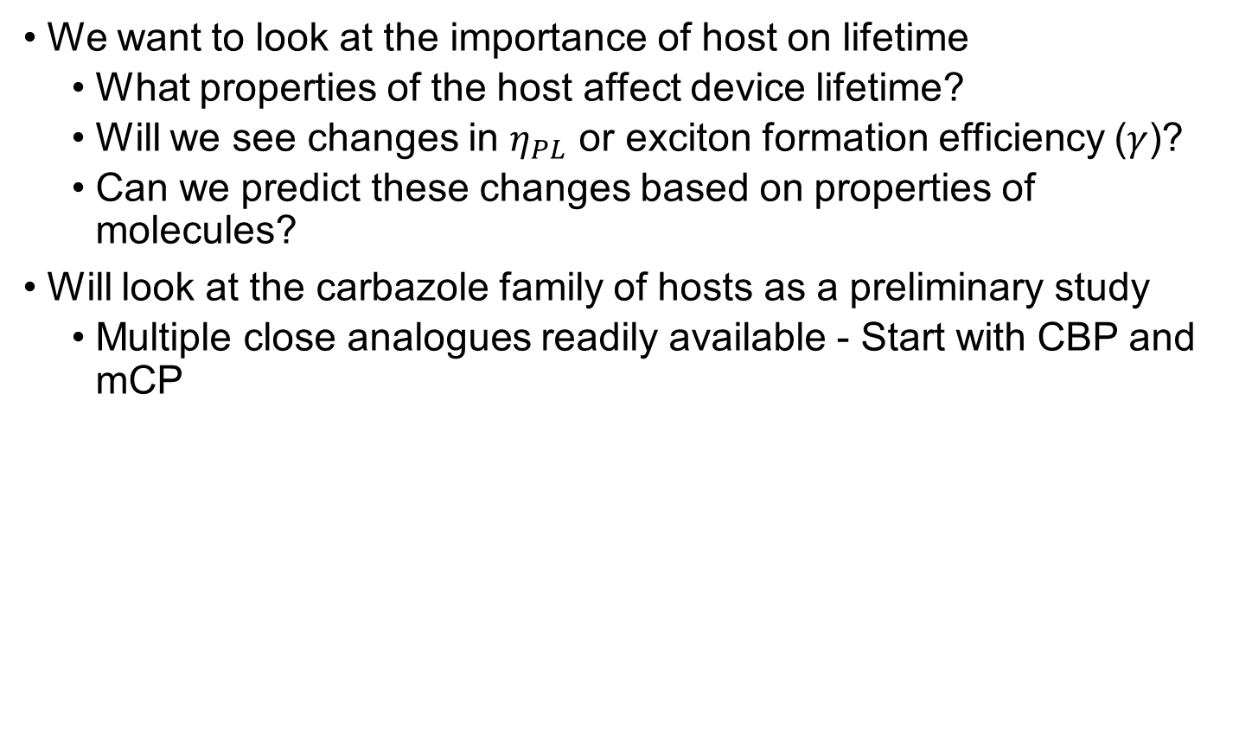
Host Comparisons
We want to look at the importance of host on lifetime
What properties of the host affect device lifetime?
Will we see changes in $η_{PL}$ or exciton formation efficiency ($γ$)?
Can we predict these changes based on properties of molecules?
Will look at the carbazole family of hosts as a preliminary study
Multiple close analogues readily available - Start with CBP and mCP
LiF/Al
CDBP
TPBi– 40 nm
CBP
Host:Irppy 6%– 20 nm
TCTA – 40 nm
mCP
ITO/Glass
BCBP

Slide 8
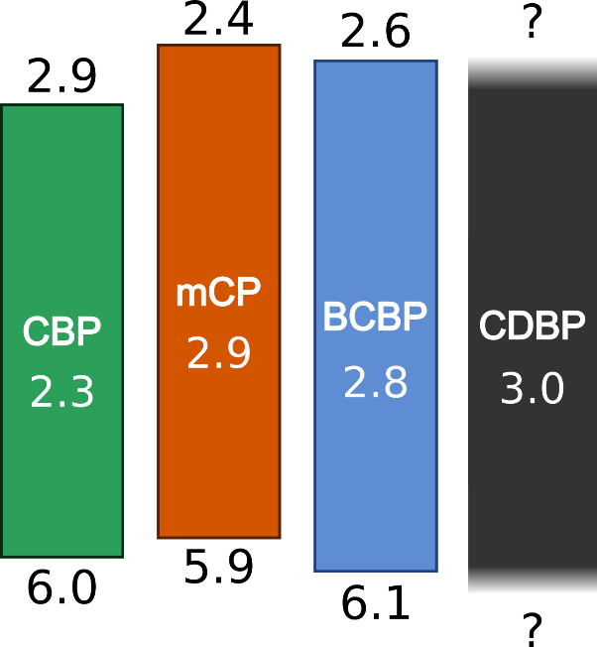
Device Statistics
CBP EQE is only significant outlier in EQE
Two hump current-voltage and luminance-voltage for all

Slide 9
Lifetime Data

Slide 10
Trends
No conclusive trends

Slide 11
Future Work - Hosts
No clear trends with EL behavior between hosts
Want to look at optical only degradation
Simpler degradation
Simpler architectures
Just host and emitter
Hypothesis:
Excess energy increases degradation rate
Would trend with Triplet Energy
Unknown if pump wavelength matters

Slide 12
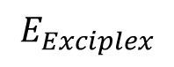
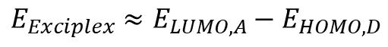
Exciplex Forming Co-Hosts
D
A
$$E_{Exciplex}$$
$$E_{Exciplex}≈E_{LUMO,A}−E_{HOMO,D}$$
Exciplexes are an emissive state that form between the LUMO of an acceptor and the HOMO of a donor
Exciplex energy can be readily tuned by changing either the donor or the acceptor
How does energy of co-host exciplex affect degradation?
[1] B. S. Kim, J. Y. Lee, Adv. Funct. Mater. 2014, 24, 3970. [2] Y.-S. Park et al. Adv. Funct. Mater. 2013, 23, 4914.

Slide 13
Exciplex Co-Hosts: Electrical Degradation
Li-acac + Al
TPBi 35 nm
L₀=1,000 cd/m²
Co-Host:Ir(ppy)₃ (5%) 30 nm
TCTA 35 nm
AQ1250/ITO/Glass
mCP-TPBi shows slightly better stability in PL than TCTA-TPBi
TCTA-B3PYMPM has dramatically lower lifetime
Could be due to morphological instability
B3PYMPM appears to crystallize easily
Need to compare across a wider range of co-hosts to see if trend emerges

Slide 14
Exciplex Co-Hosts: Optical Degradation
405 laser
Beam expander
Detector
To simplify comparisons, we compared degradation under optical excitation
Reduces complexities due to charge carriers and differences in recombination zone
Devices are illuminated with 405 nm laser
Power generates an exciton density equivalent to ~500 cd/m²
Same general trend is seen

Slide 15
Exciplex Co-Hosts: Future Work
Not clear if lifetime differences are due to co-host properties or limited by morphological stability
Study wider range of co-host pairs
Continue studying optical degradation
Influence of pump wavelength (pump guest and host)
Influence of pump power density
Study role of charge carriers with single-carrier devices

